Slide 1
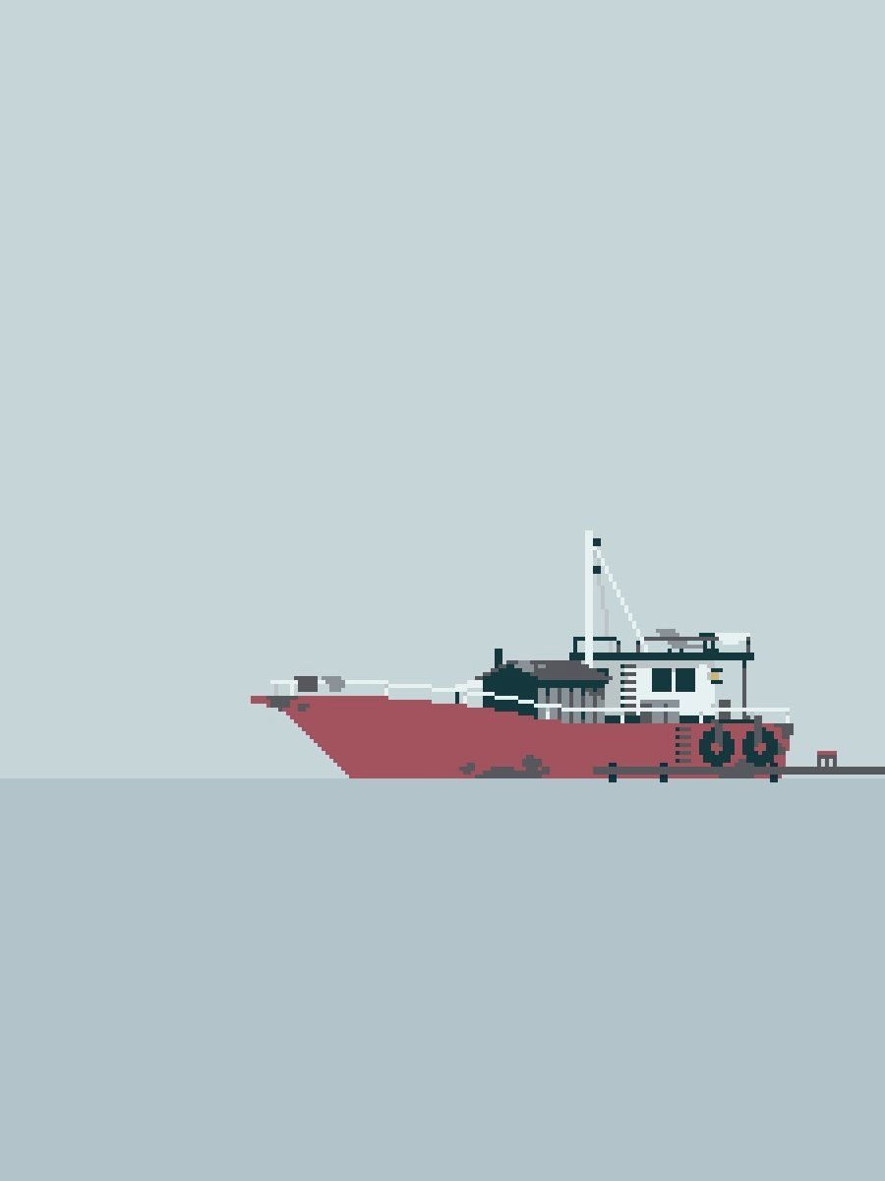
Battleship
Claire Chou and Coleman Reed

Slide 2
What is Battleship?

Slide 3
Battleship
Strategy-based guessing game
Two players
Two 10 x 10 boards
Ships of size 2, 3, 4, 5
The objective of the game is to destroy all your opponent’s ships.

Slide 4
Rules of Battleship
Place ships anywhere on board
Cannot be touching
Location of ships are concealed from other player
Alternate turns guessing location of ships on opposing player’s board
Player must announce when a ship has been hit or sunk
Win by destroying all ships before other player

Slide 5
Aspects/Features
User vs. CPU
Place ships
Play game
CPU vs. CPU
View game
CPU difficulty
Easy, medium, hard

Slide 6
User Interface & Interaction
Main menu
User vs. CPU
CPU vs. CPU
How to Play
Difficulty settings
Place ships
Game board

Slide 7
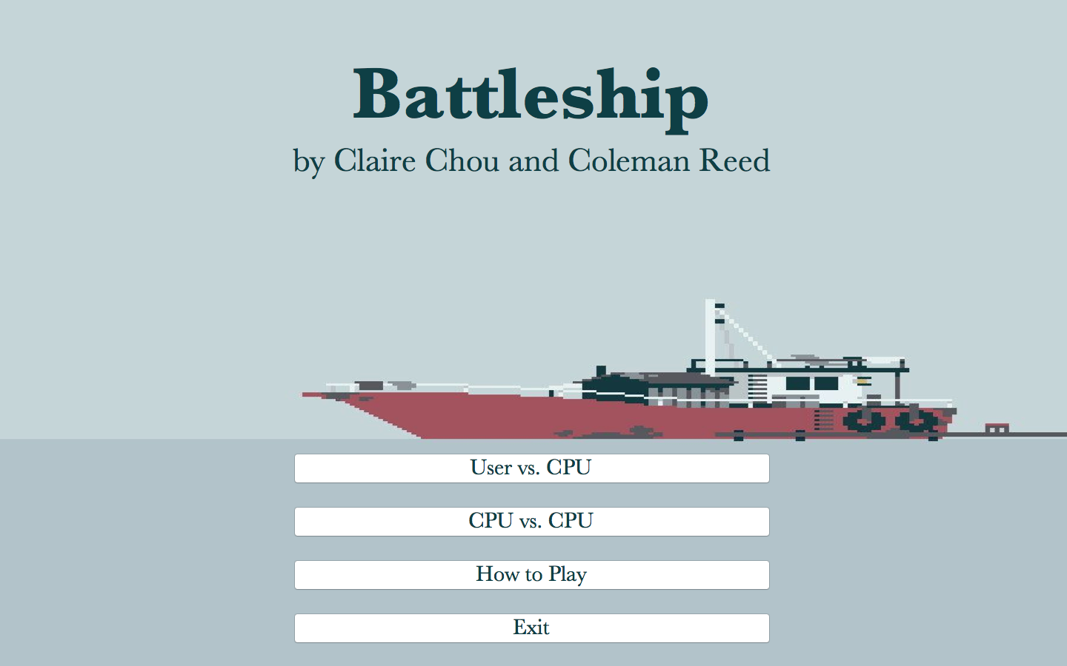

Slide 8
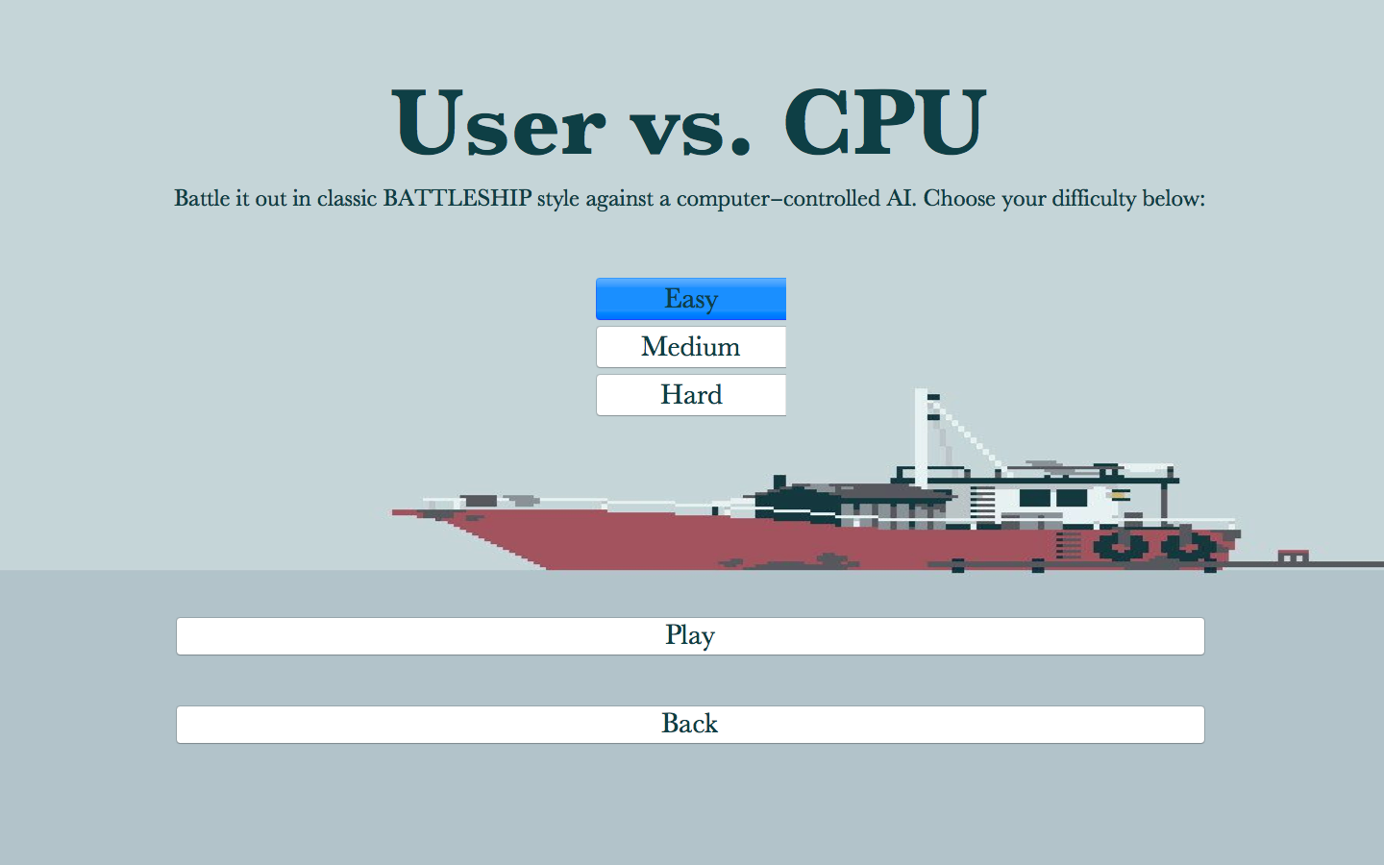

Slide 9
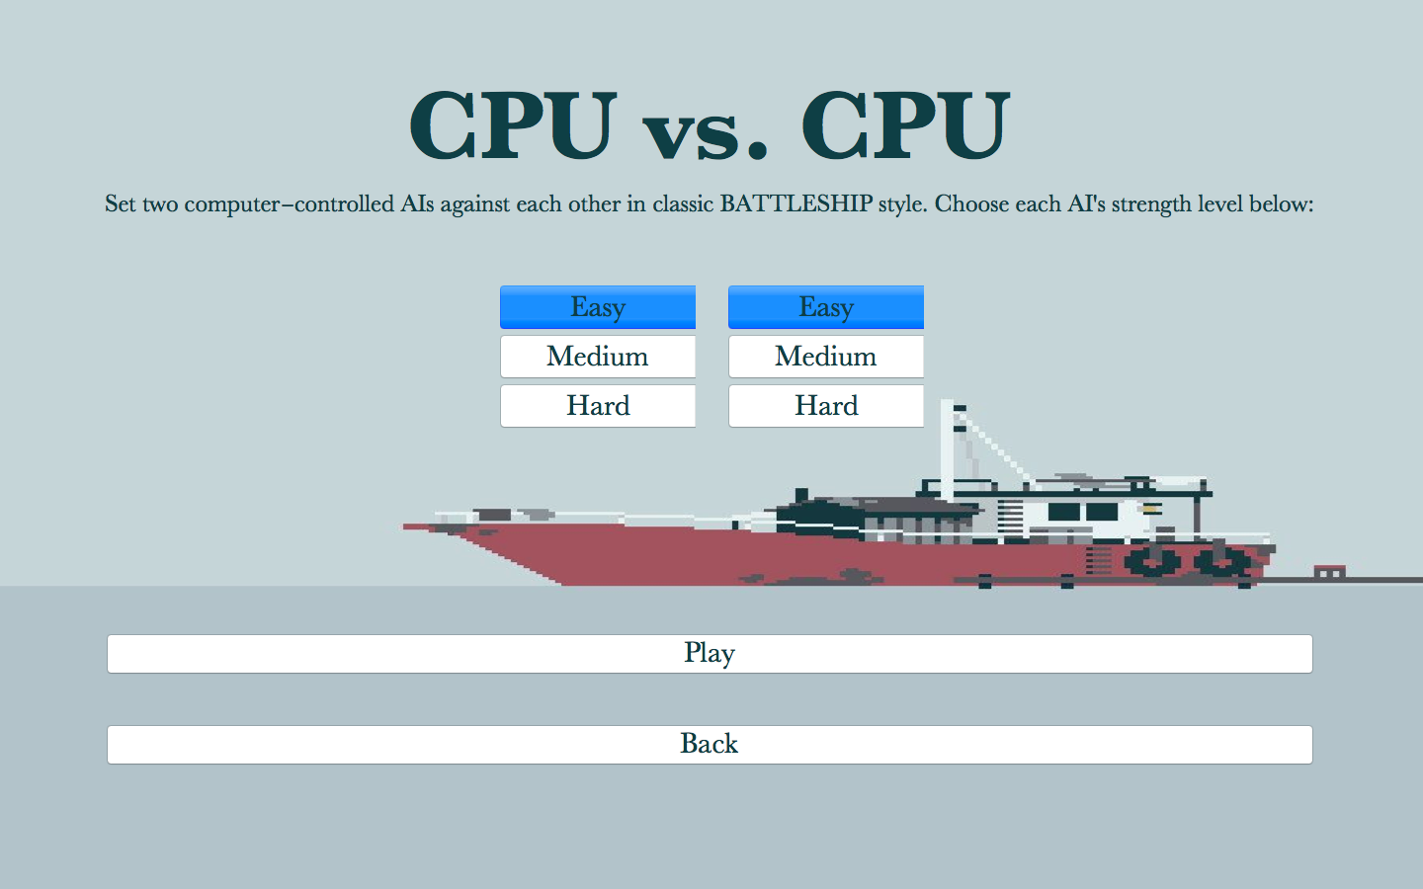

Slide 10
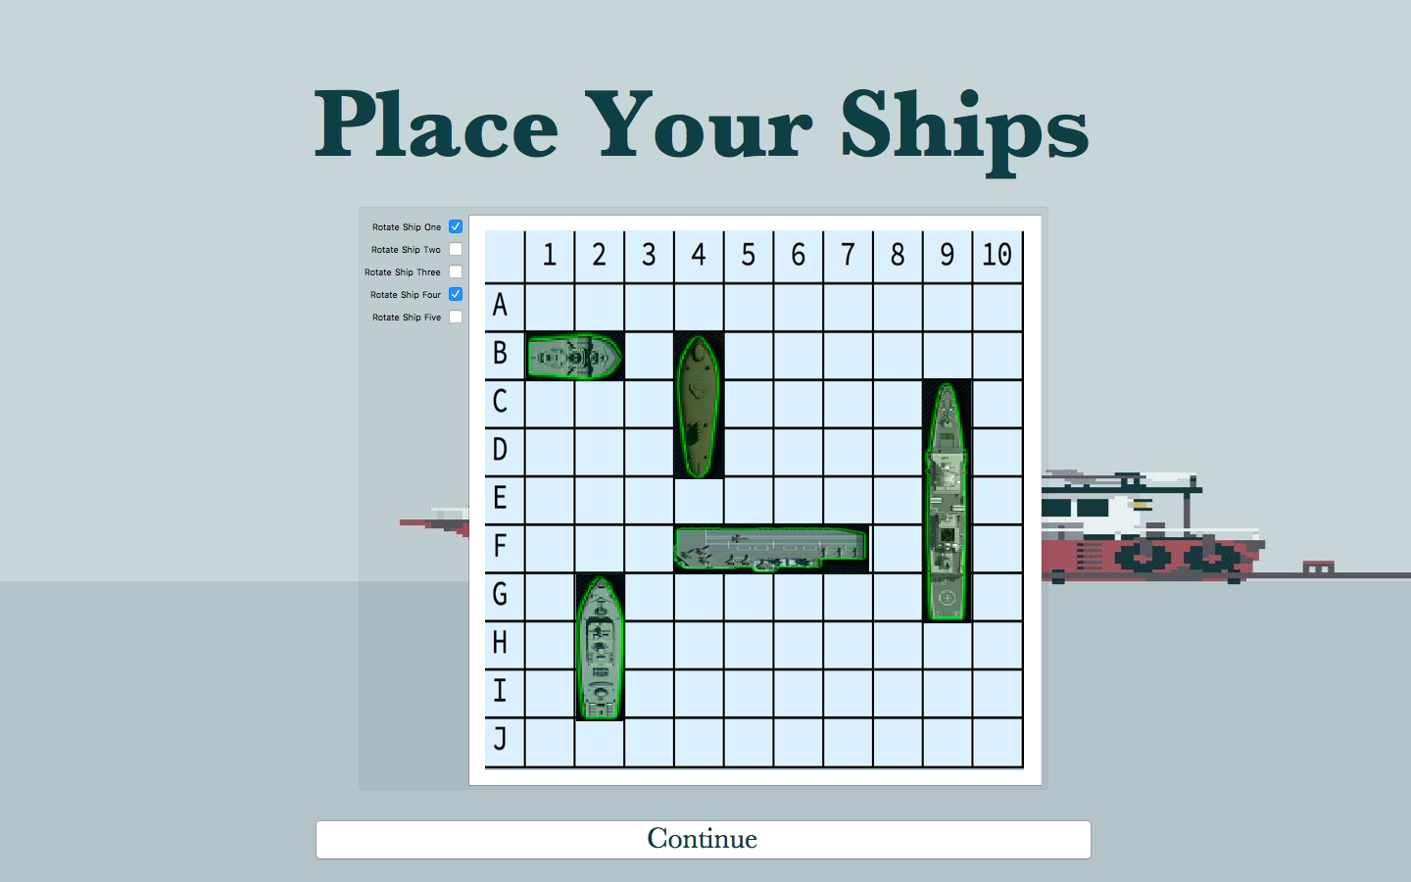

Slide 11
Our program

Slide 12
Data Structures (10 x 10 lists)
User & CPU board values
0 = nothing, 1 = ship
User guesses
0 = nothing, 1 = miss, 2 = hit
CPU guesses
0 = nothing, 1 = guess

Slide 13
CPU algorithms
Searching for a ship
cpuEasy[] - random guess
cpuMedium[] - parity and probability
cpuHard[] - probability density matrix

Slide 14
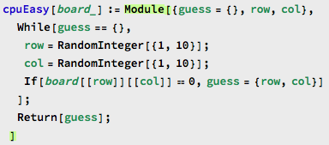
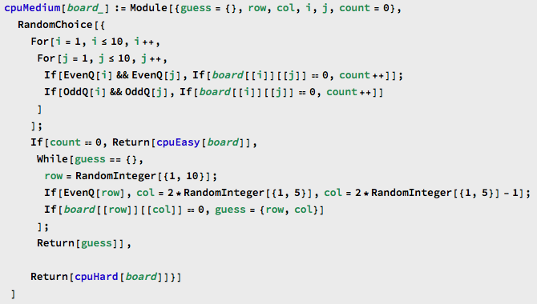
Returns random location where CPU has not guessed
Returns either every other grid or location with highest probability (cpuHard[])
If all odd squares have been guessed, will return random location (cpuEasy[])
RandomChoice gives a pseudorandom choice of one of the arguments

Slide 15
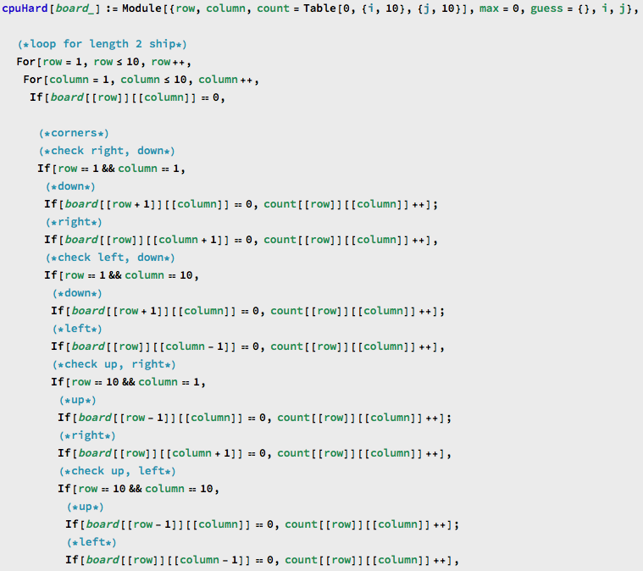
Nested for loop for each size ship
If statements for corners, edges
Counts number of possible ways each size ship in each possible orientation fits in each grid
Returns location of highest count

Slide 16
CPU algorithms
Destroying a ship
target[] - checks above, below, left, right of a hit
target2[] - checks in direction given by previous two hits

Slide 17
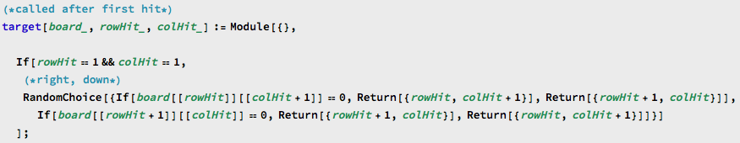
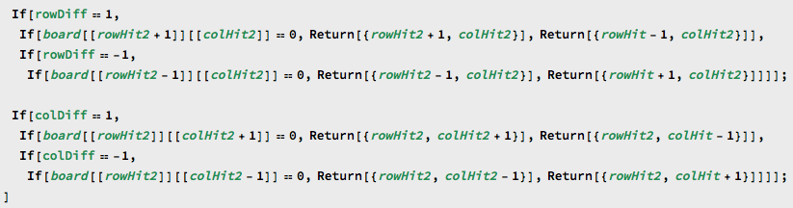
Randomly returns location above, below, to the left of, or to the right of hit where CPU has not guessed
Returns location based on previous two hits by checking whether ship is horizontal or vertical

Slide 18
CPU algorithms
Random Ship Placement
aiBoardGen[]
Creates a board, 10x10 in size, with ships randomly placed. The ships cannot be directly beside each other.

Slide 19
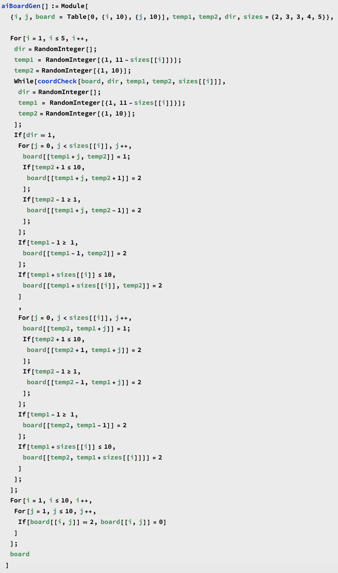
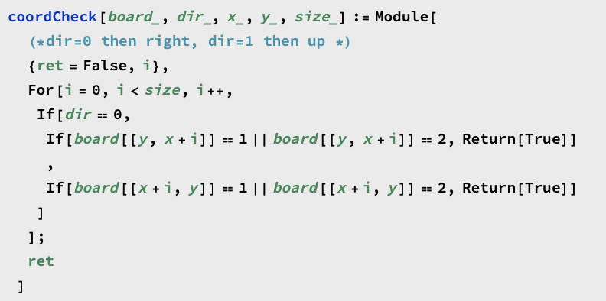
coordCheck makes sure the selected spot for building a ship is valid
1s represent placed ships, 2s represent places where a ship cannot be placed

Slide 20
playGame[] & displayBoard[]
CreateWindow, DialogNotebook
Creates window of game
GraphicsGrid, Button
User’s board and ships can be seen
User’s and CPU’s guesses can be seen
User guesses through table of buttons on CPU’s board
isSunk[] to change color of ship once sunk

Slide 21
playGame[] helpers
isWon[] & isWonCPU[]
Control structure
isSunkUser[] & isSunkCPU[]
Used in CPU algorithm
Used in UI
move[] & moveCPU[]
Updates lists of guesses

Slide 22
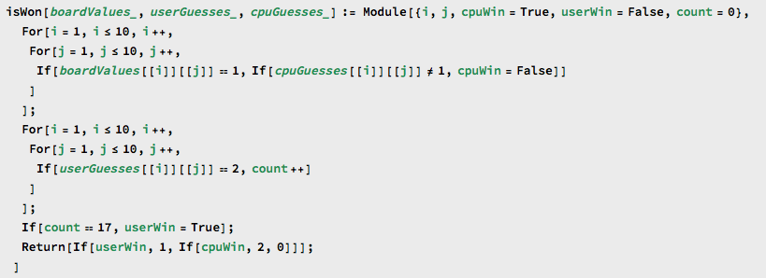
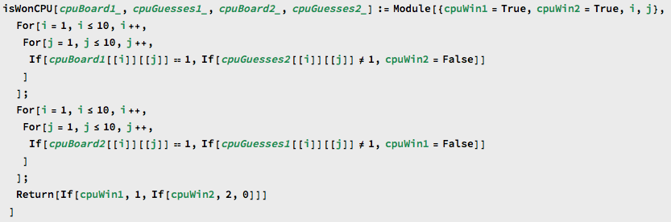
Returns 0 if game has not been won, 1 if user has won, 2 if CPU has won
CPU: compares board values to guesses; for CPU to win, wherever board is 1, CPU must have 1
User: counts number of 2s in guesses (2 = hit, 17 total grids)
Returns 0 if game has not been won, 1 if CPU 1 has won, 2 if CPU 2 has won

Slide 23
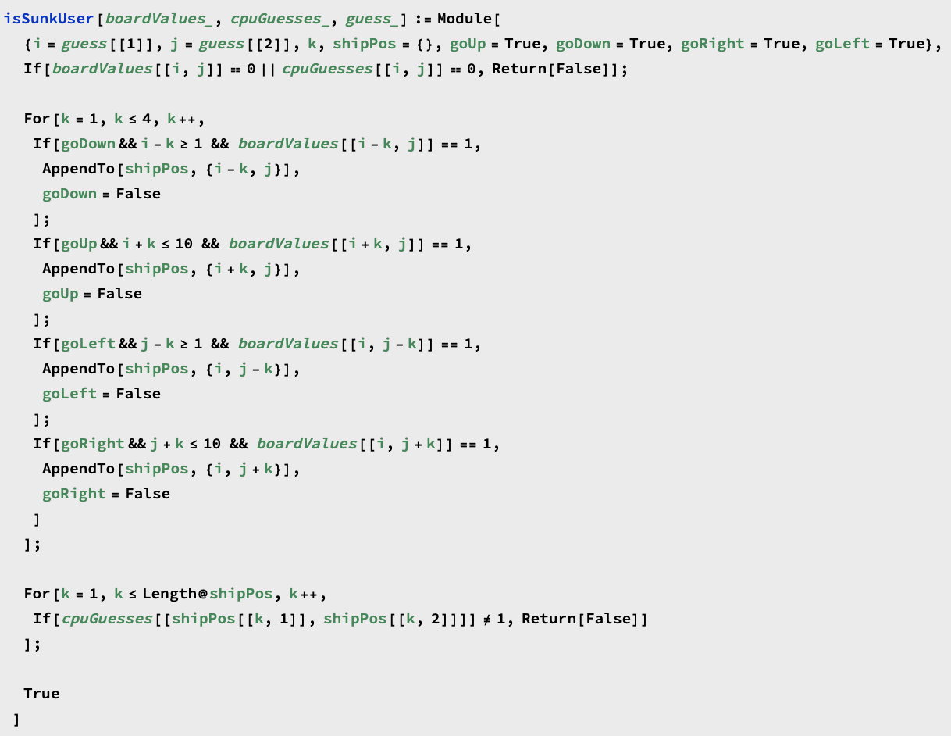

If there is a ship at the guessed point, isSunk finds all points that the ship is placed on
The only difference between isSunkUser and isSunkCPU is the last If statement

Slide 24
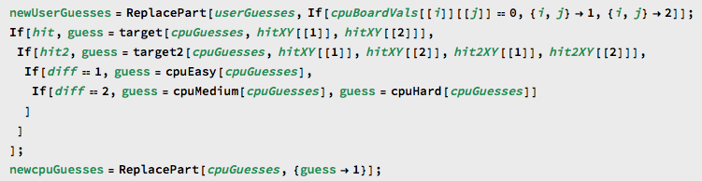
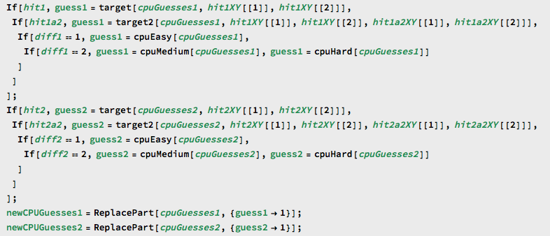
Replaces old guesses with current guesses
CPU guesses assigned based on difficulty, boolean hit

Slide 25
Place Ships
snapToGrid[centers, r1, r2, r3, r4, r5]
Handles the ‘snapping’ of ships
buildGrid[]
Helper to build placing grid
genShips[r1, r2, r3, r4, r5]
Redraws ships when a rotation happens
tableCreate[centers, r1, r2, r3, r4, r5]
Helper to create return table

Slide 26
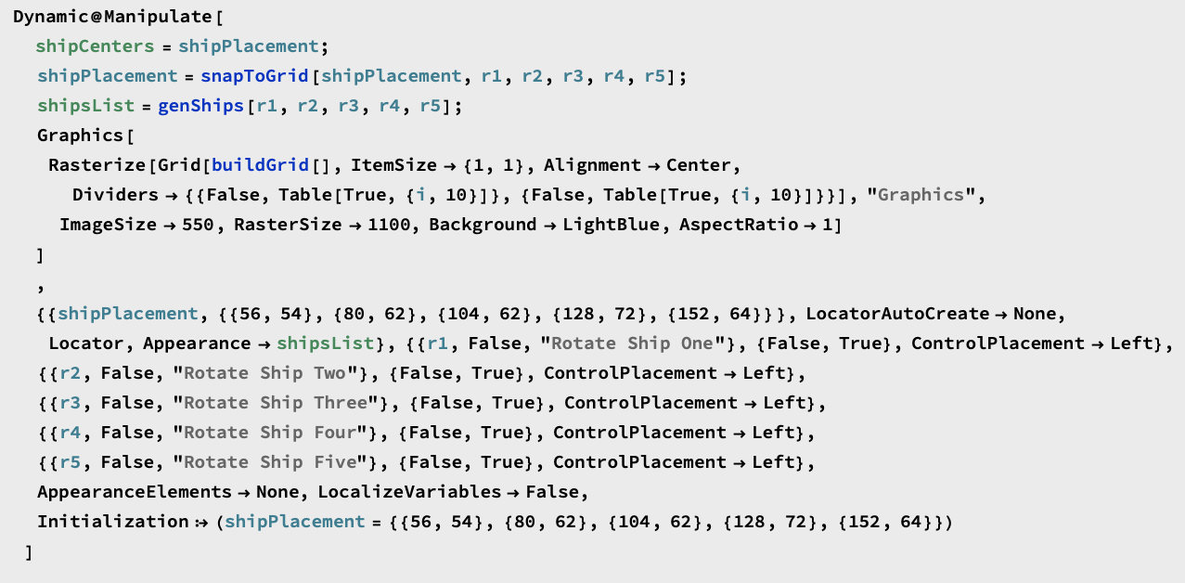
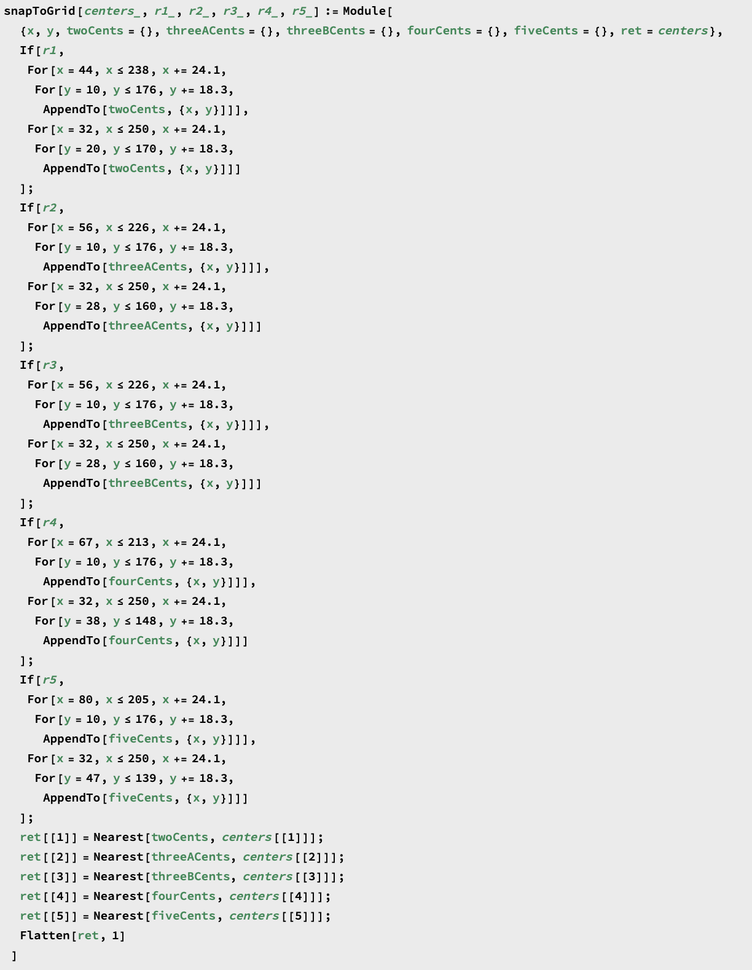
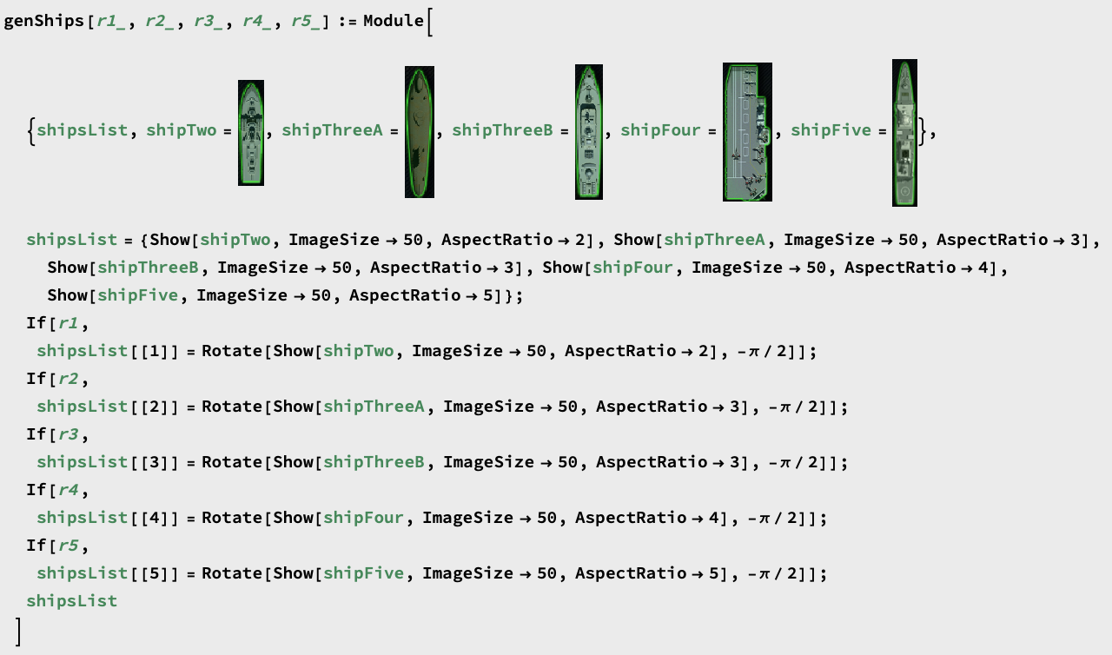

Slide 27
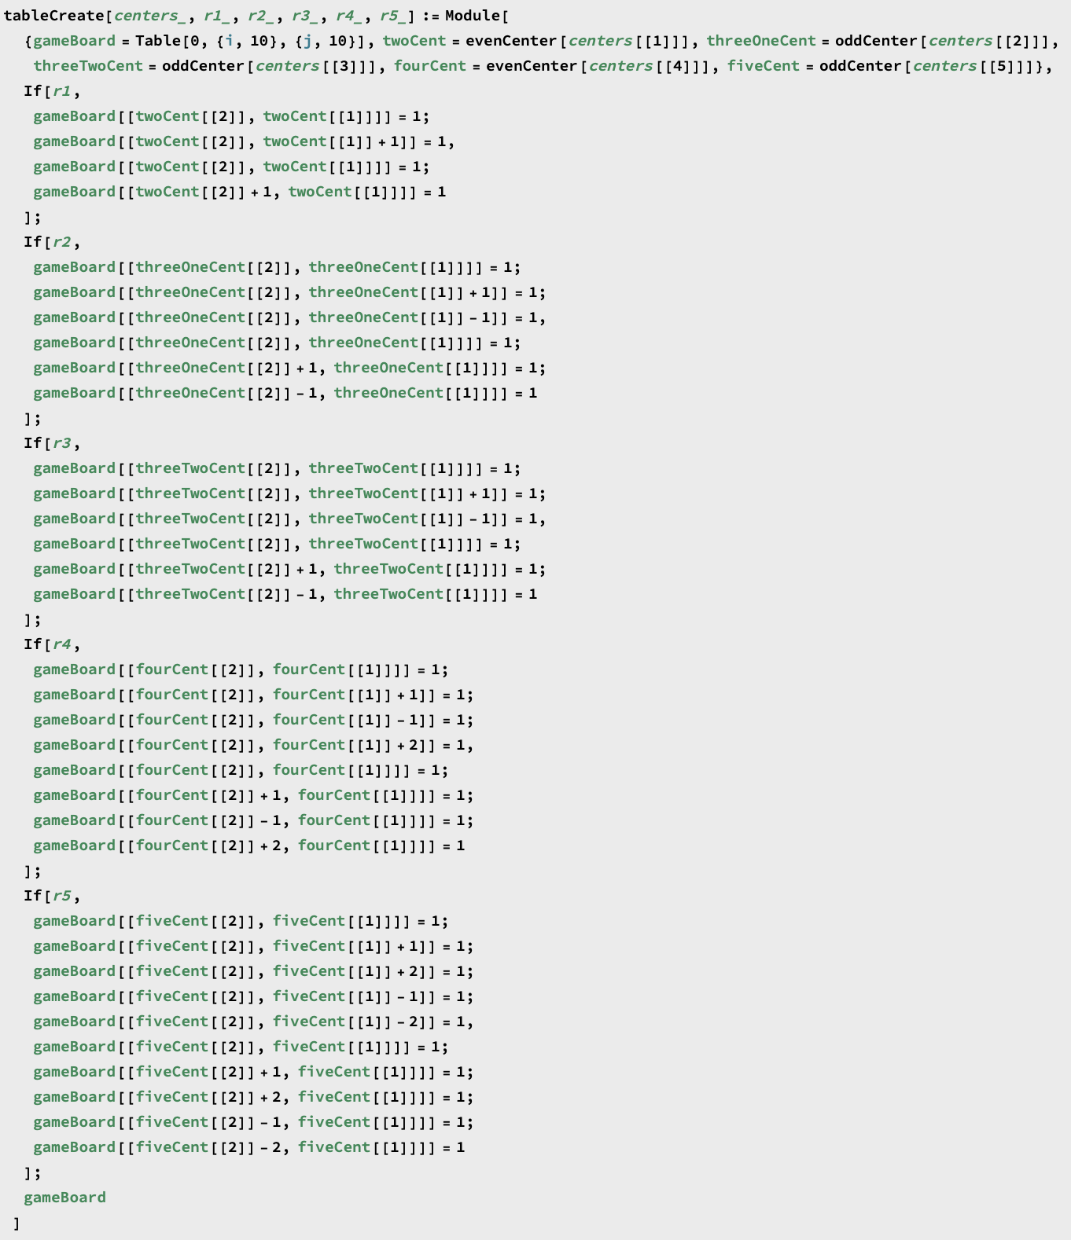
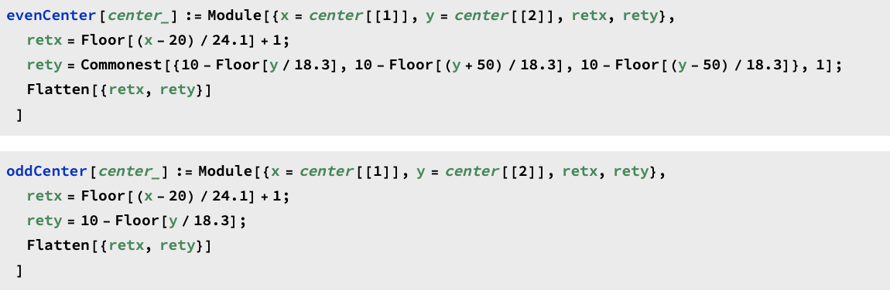
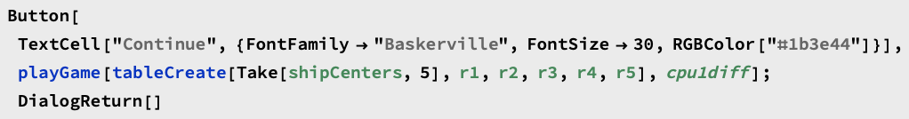
tableCreate converts the raw coordinate positions of the ships to their spots on the 10x10 board, resulting in a board of 1s and 0s where 1s represent the locations of ships

Slide 28
Problems encountered

Slide 29
Place Ships (rotate, snapping)
Rotation
Buttons and Rectangles ❌
Manipulate and Images ✔️
Snap to Grid
Rotation state
OS/Resolution

Slide 30
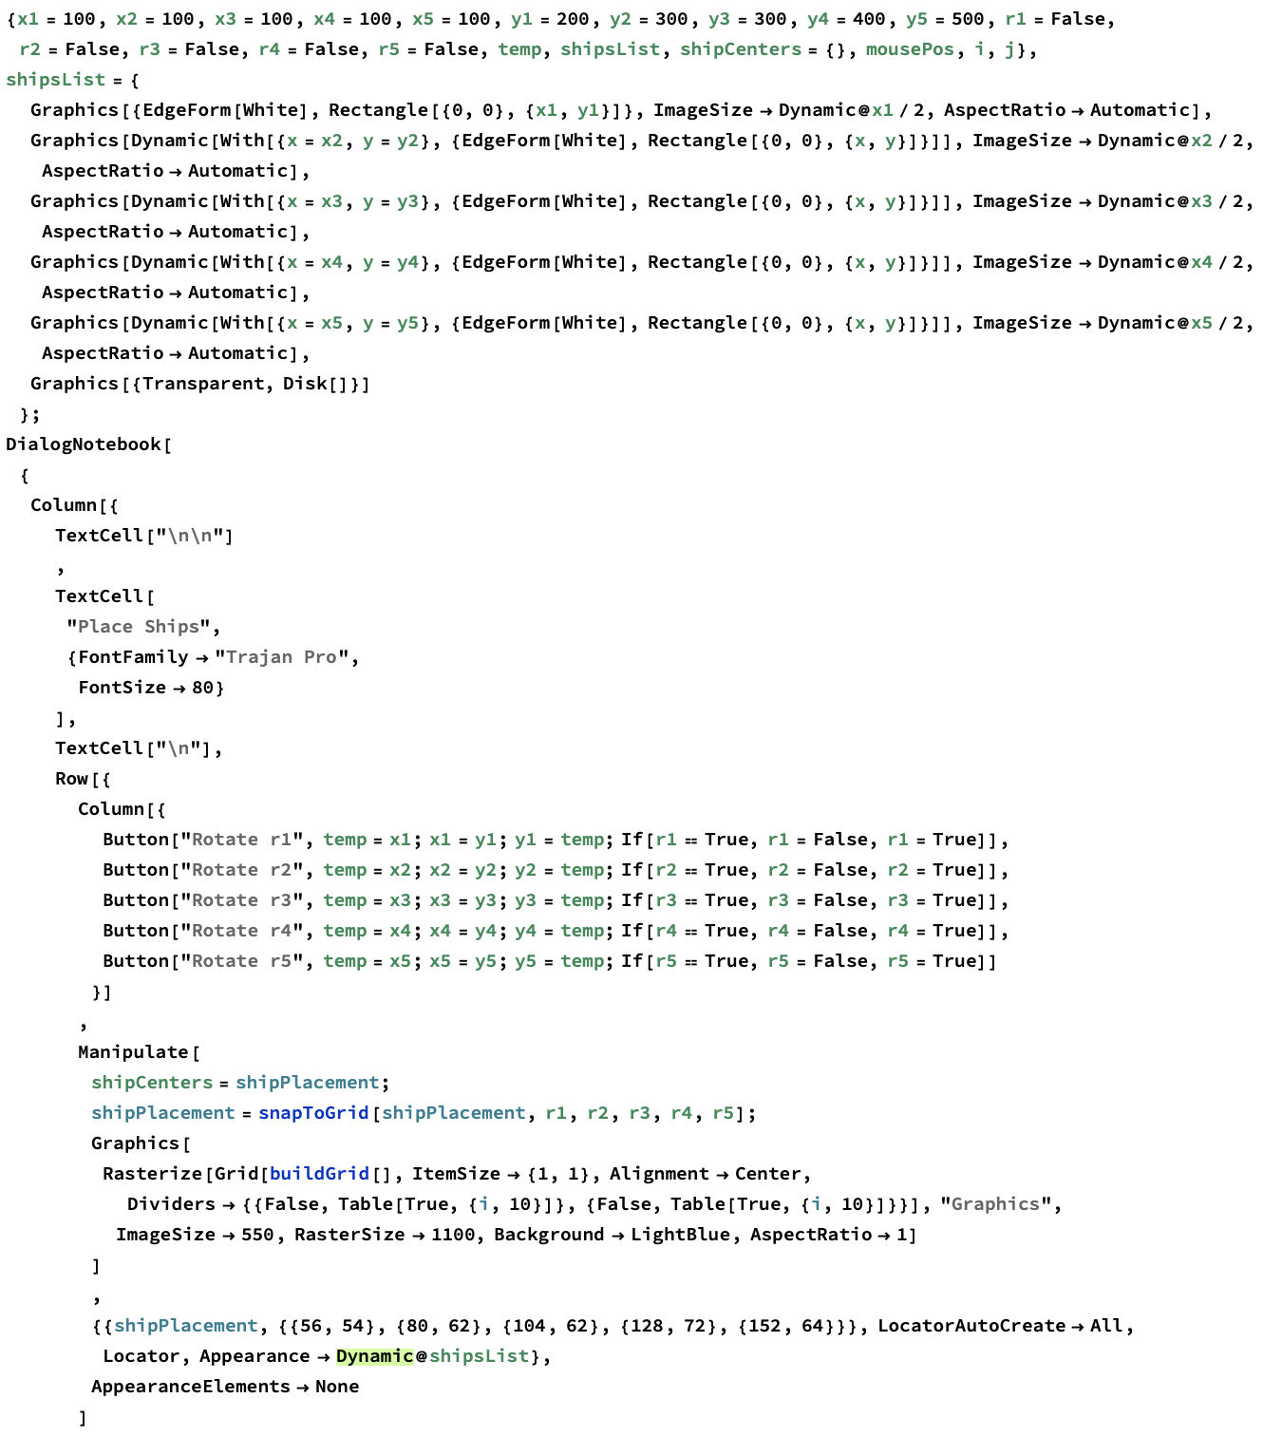
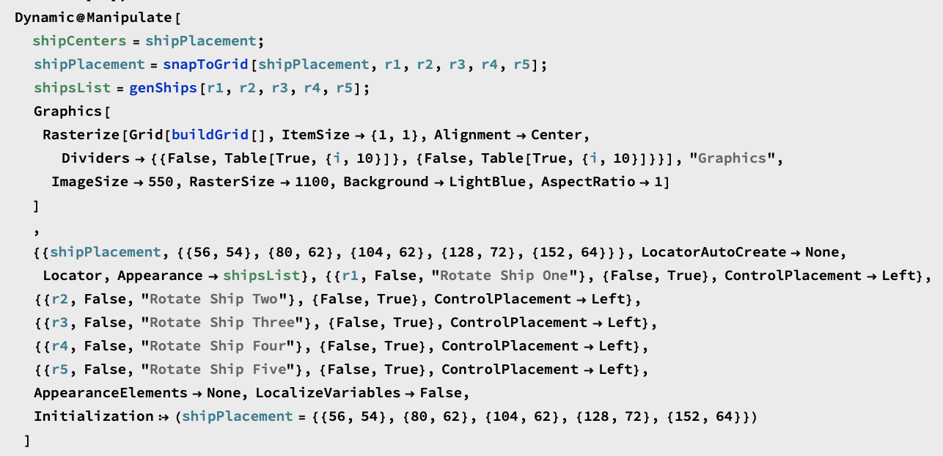

Slide 31
Implementing CPU
target2[] checking in wrong direction
Boolean variables
Count of grids hit on single ship
Store locations of previous two hits
isSunk[] resets all

Slide 32
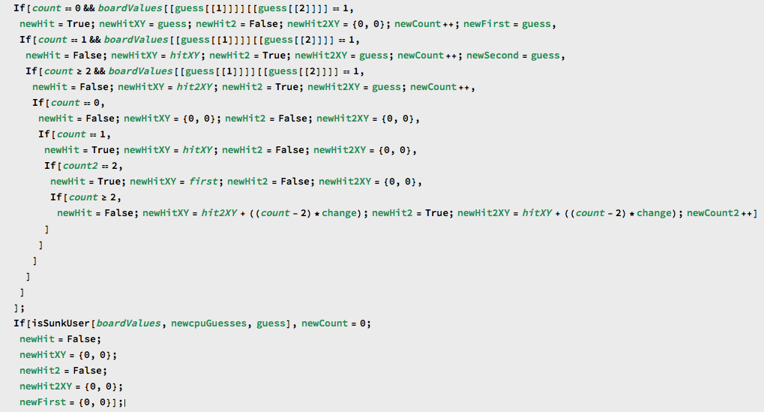
Locations of first and second hits are adjusted based on count
Count increases after each hit
After ship is sunk at guess, resets variables

Slide 33
Live demo

